Slide 1
RUNGTA COLLEGE OF DENTAL SCIENCES AND RESEARCH
ANAEMIA
DEPARTMENT OF GENERAL MEDICINE

Slide 2
SPECIFIC LEARNING OBJECTIVES
MUST KNOW | NICE TO KNOW | DESIRE TO KNOW
DEFINITION | NORMAL VALUES | EXAMINATION OF PATIENT
CLASSIFICATION | TYPES OF ANAEMIAS | FANCONI ANAEMIA
APLASTIC ANAEMIA | PANCYTOPENIA

Slide 3
CONTENTS
DEFINITIONS
CLASSIFICATIONS
EXAMINATION OF PATIENTS
ANAEMIA OF SYSTEMIC DISORDERS
ANAEMIA OF INFECTION
ANAEMIA OF CHRONIC RENAL FAILURE
PANCYTOPENIA
APLASTIC ANAEMIA
FANCONI ANAEMIA
SUMMARY

Slide 4
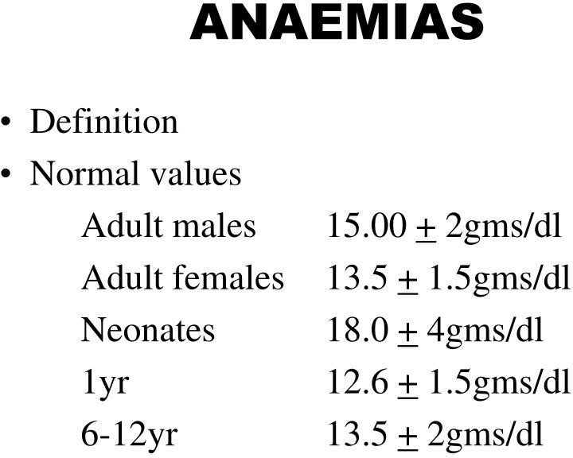

Slide 6
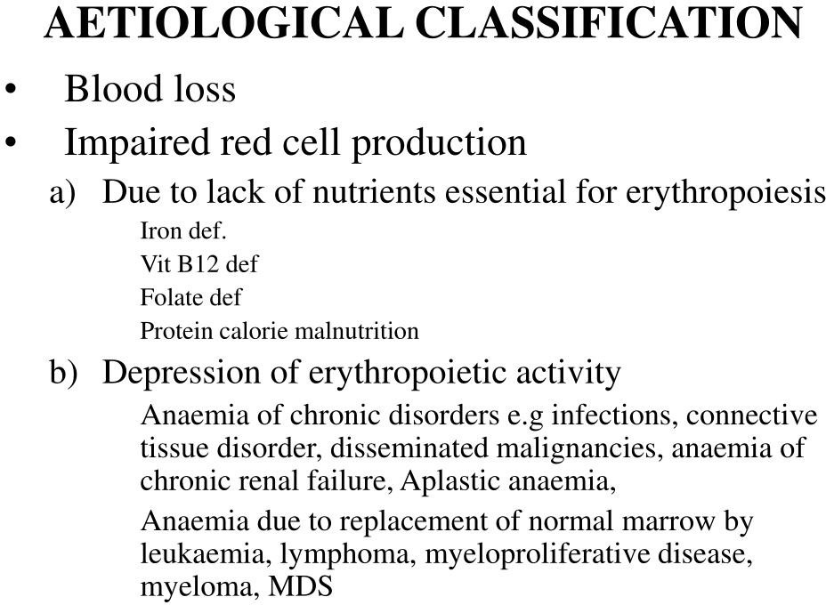

Slide 7
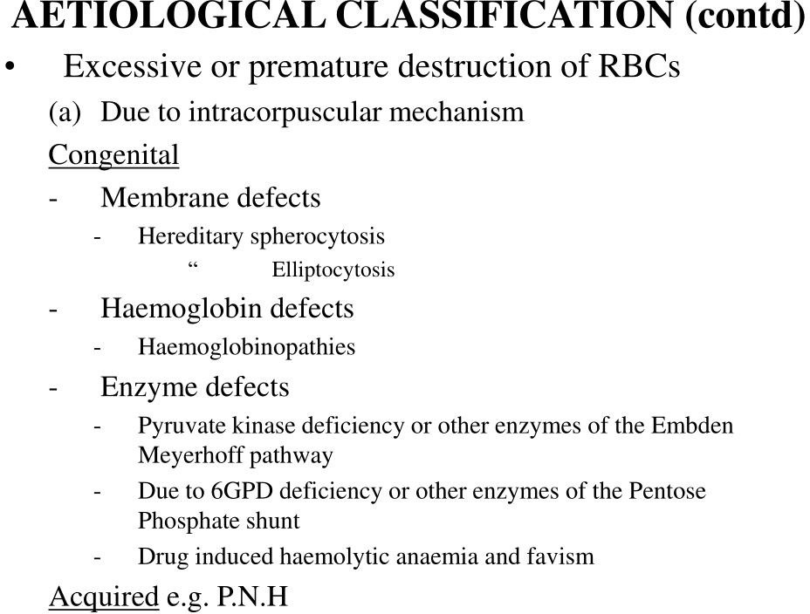

Slide 8
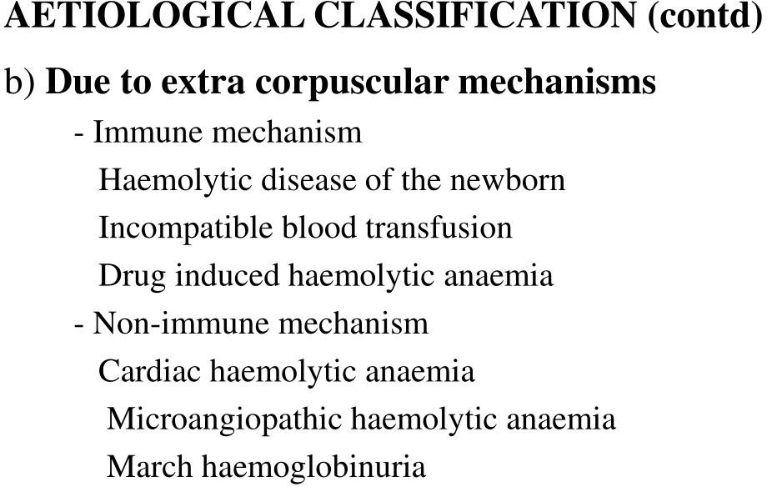

Slide 9
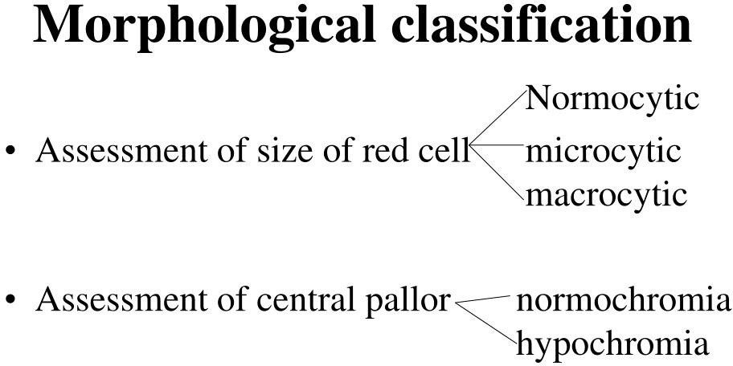

Slide 10
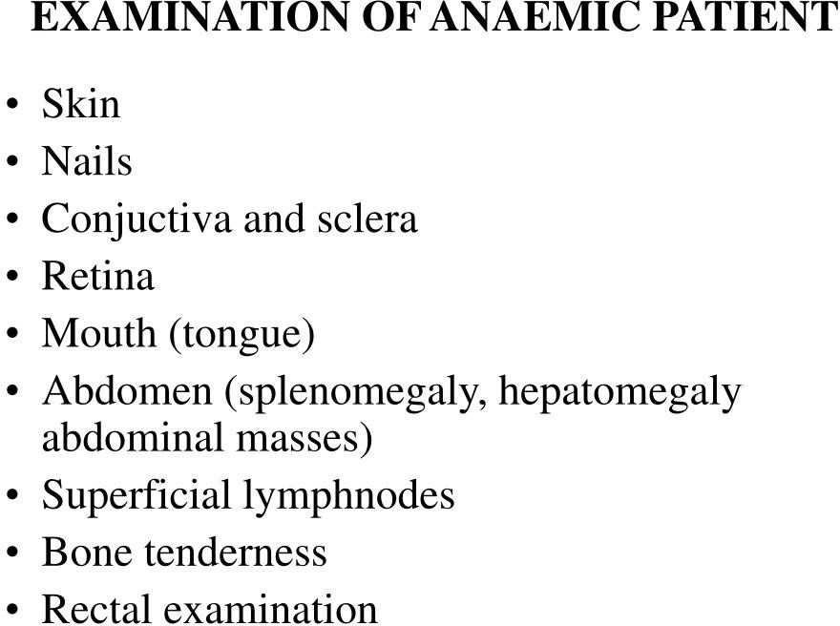

Slide 11
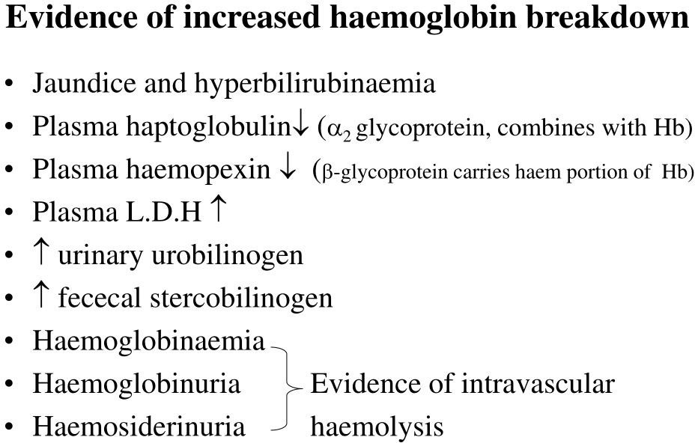

Slide 12
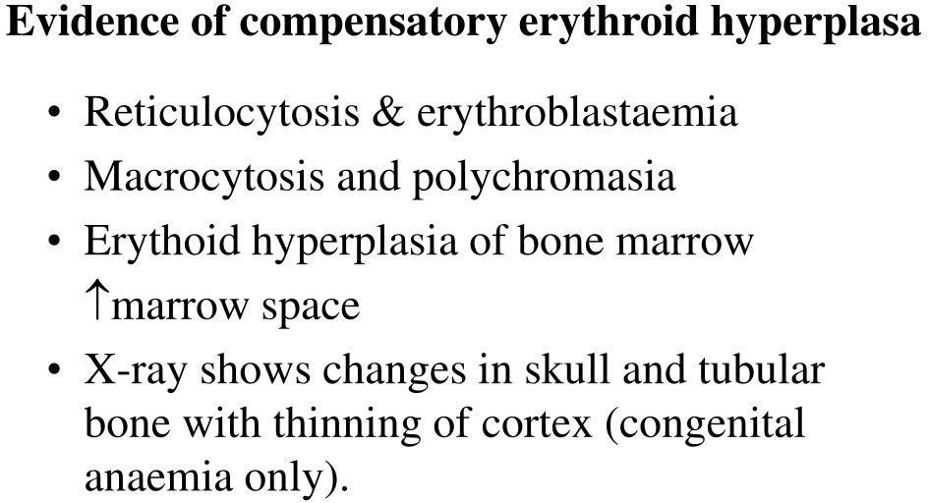

Slide 13
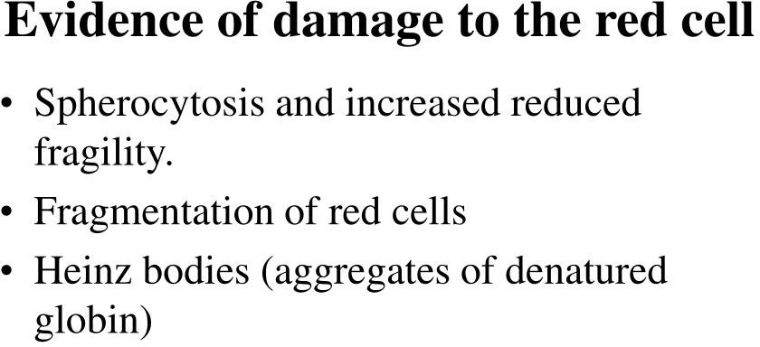

Slide 18
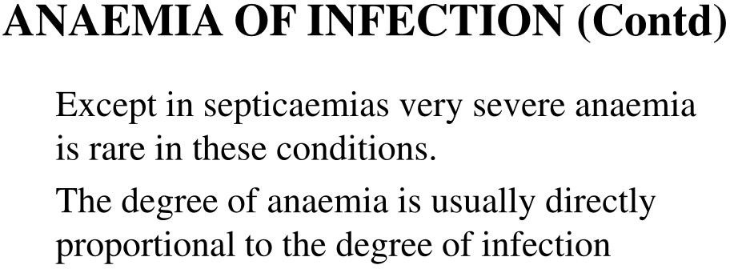

Slide 31
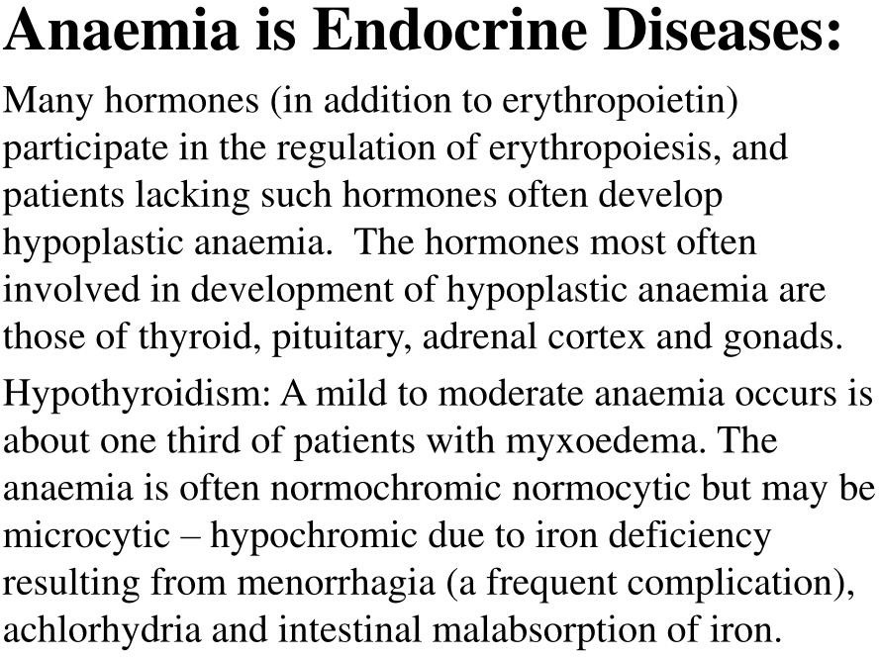

Slide 34
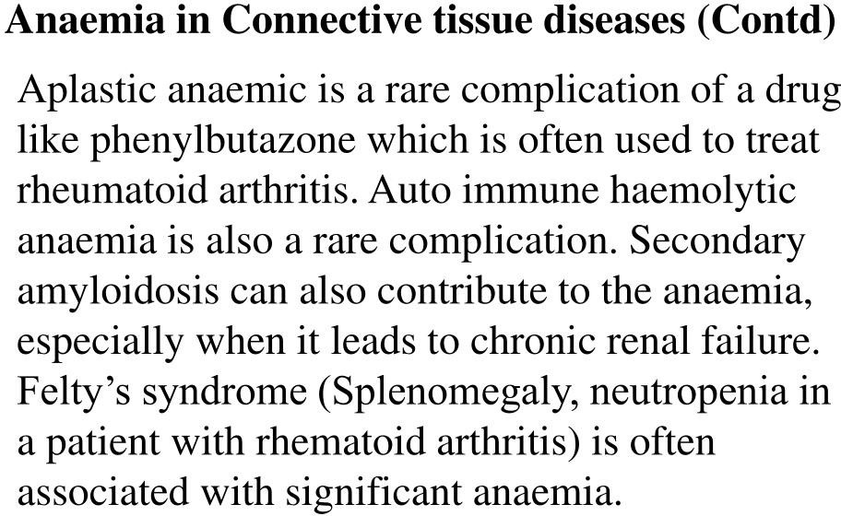

Slide 36
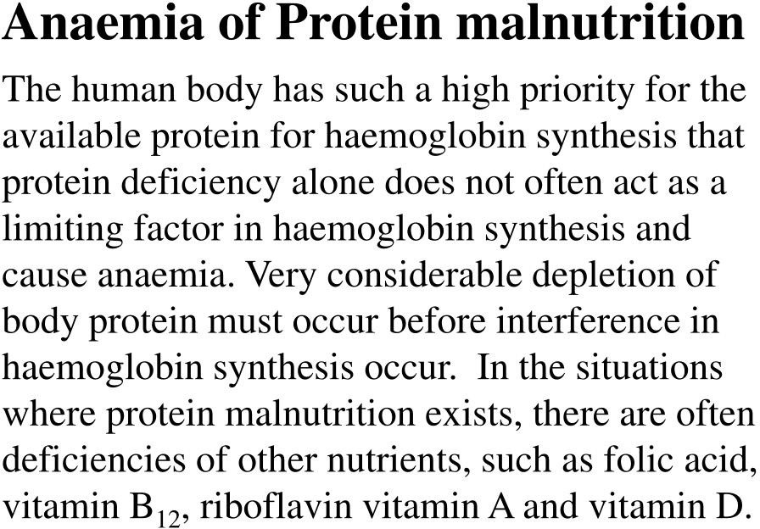

Slide 37
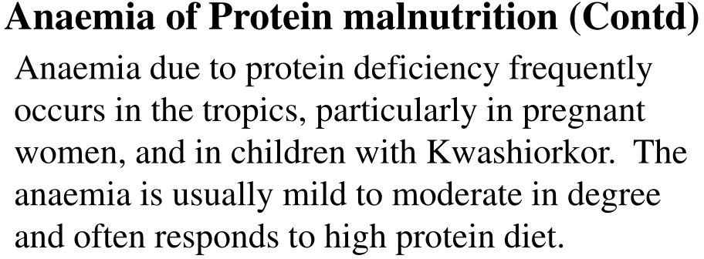

Slide 38
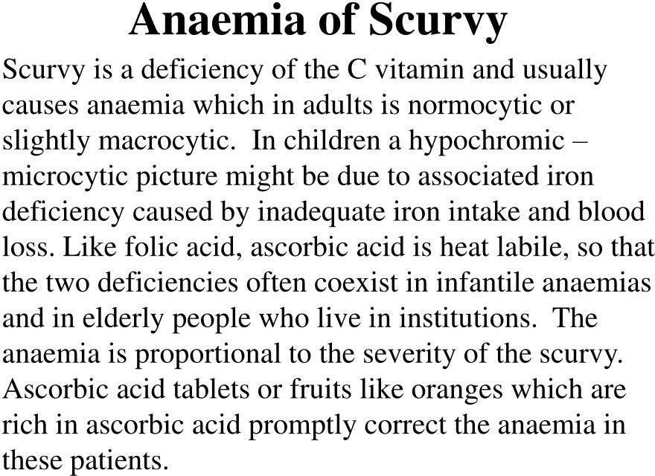

Slide 46
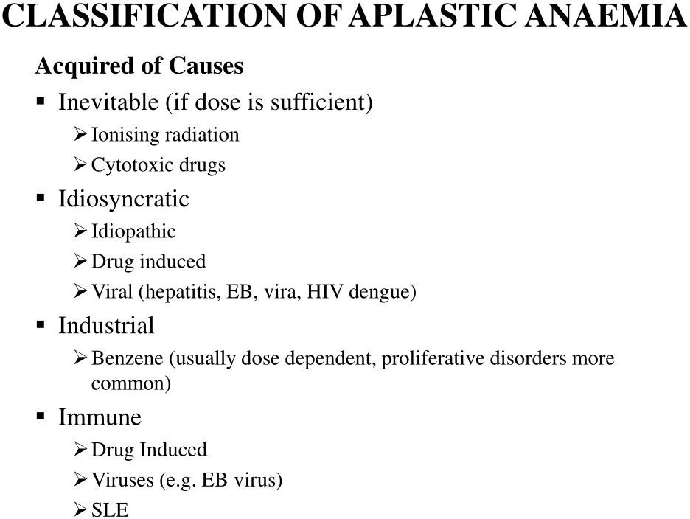

Slide 47
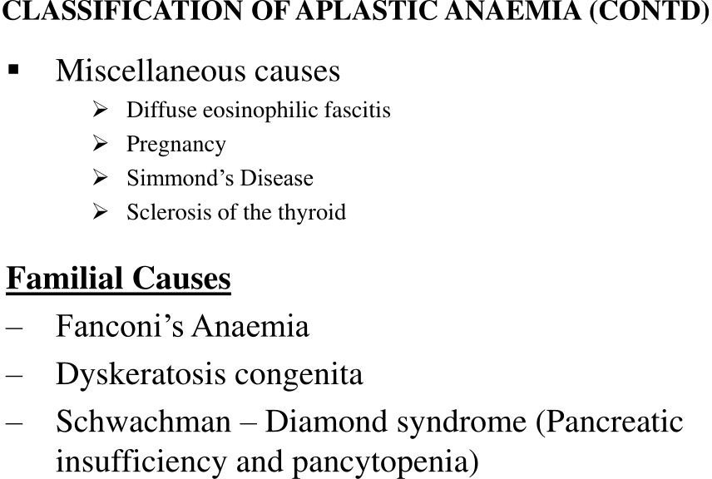

Slide 48
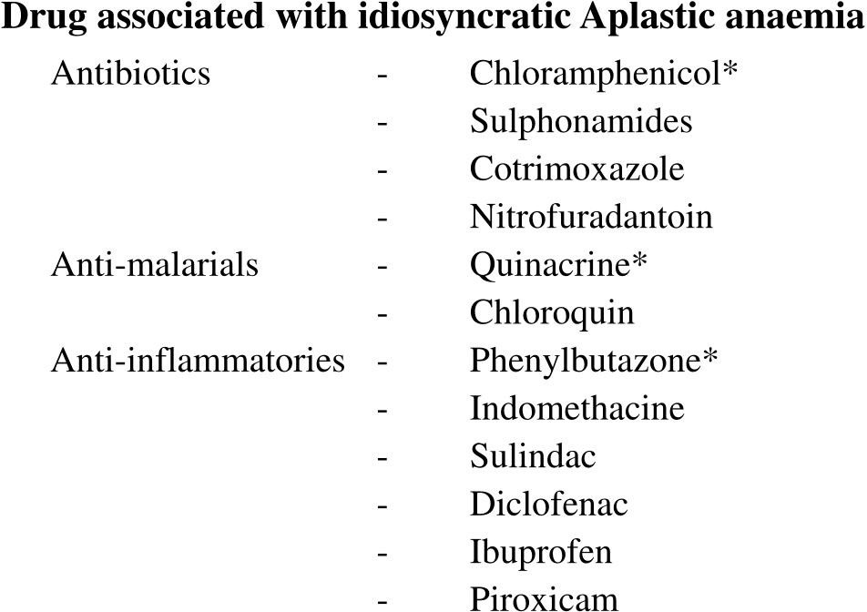

Slide 49
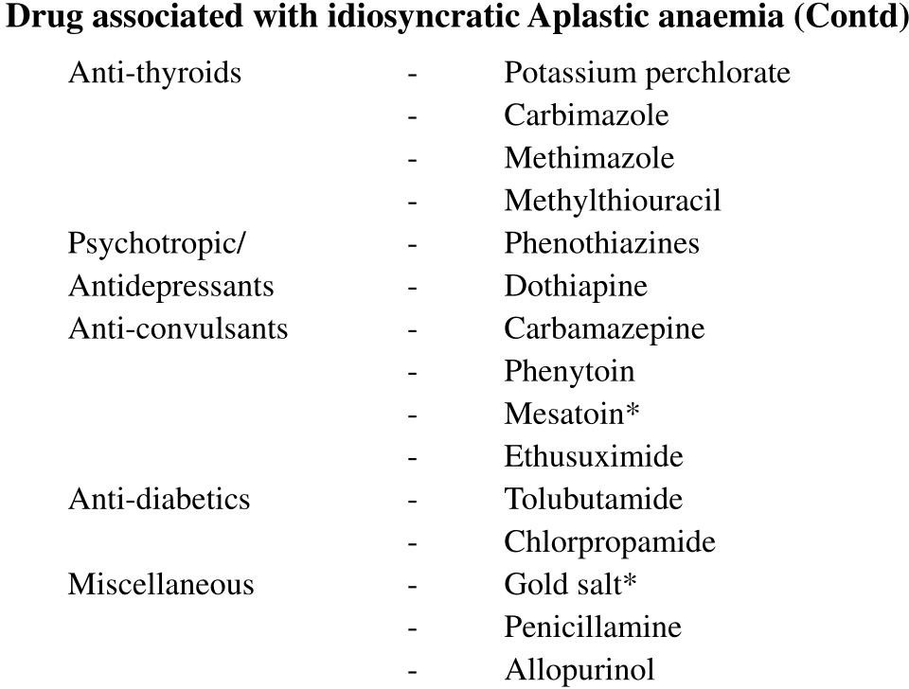

Slide 53
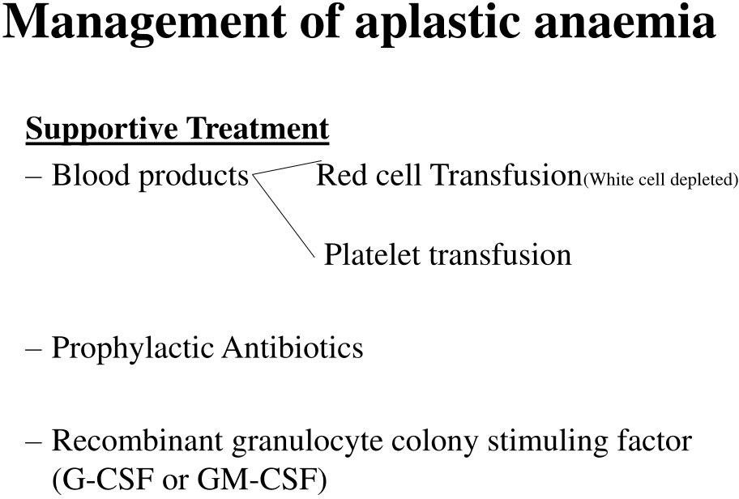

Slide 54
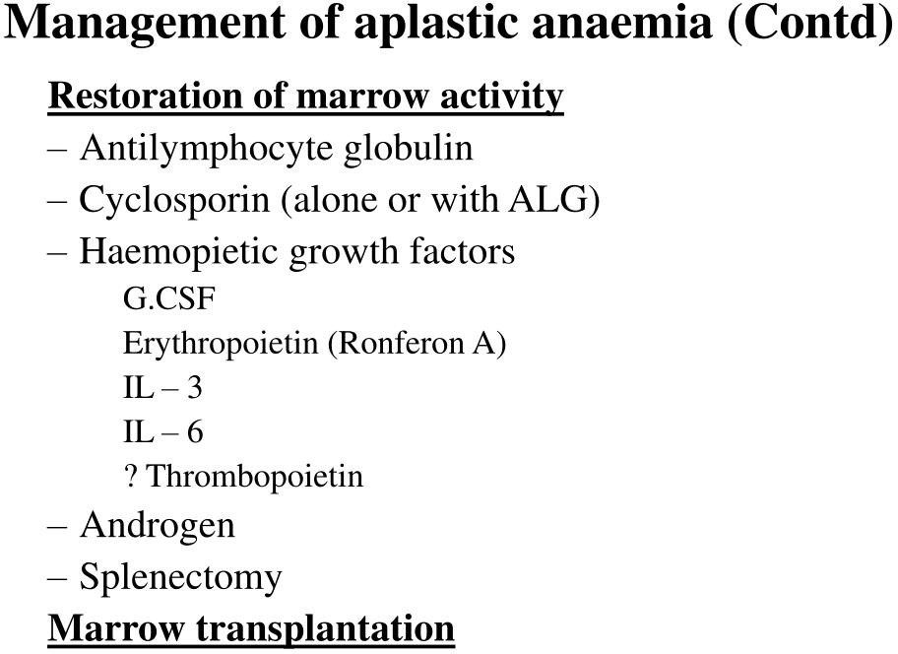

Slide 56
SUMMARY

Slide 57
REFERENCES
DAVIDSON’S PRINCIPLES AND PRACTICE OF MEDICINE; 23rd edition
HARRISON’S PRINCIPLE OF INTERNAL MEDICINE; 21ST edition
TEXTBOOK OF CLINICAL MEDICINE by S.N Chugh ;5th edition

Slide 58
QUESTIONS AND ANSWERS

